Slide 2

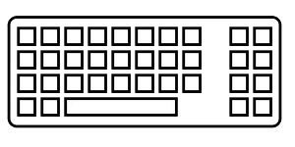
Coding is great
but
coding as a pair is better
Introduction to
Pair Programming

Slide 3
So, Pair Programming …
… what is that?

Slide 4
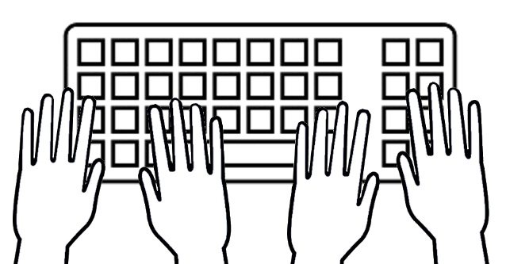
This is not
four-handed piano

Slide 5
This is not
four-handed piano
Both members of the pair are active at the same time, but differently
One “pilot” and one “navigator”, who regularly exchange roles
Non-frozen pairs, that change on a regular basis
The initial cost of a development is not actually doubled

Slide 6

Precautions of use

Slide 7
Precautions of use
Working as a pair is not that easy, and requires energy
It is important to keep a protected personal space
Do not systematize this practice to each and all daily tasks
This no silver bullet, resolving every issue

Slide 8
Okay, but …
… for what purpose?

Slide 9

The best of
both brains

Slide 10
The best of
both brains
The effects of cognitive biases are limited, notably Confirmation Bias
The feedback loop is as short as possible
The intention must always be clearly expressed
The designing aspect of development is strengthened

Slide 11

Collective benefits

Slide 12
Collective benefits
Collective ownership of the code increases each one's involvement
This practice limits problems of ego, and also “blame culture”
The distribution of knowledge and skills is facilitated
The "PR review" phase is generally (far) less laborious
Team growth is facilitated: transfer and sharing are continuous

Slide 13

Pair Programming
and
Test Driven Development

Slide 14
Pair Programming
and
Test Driven Development
Having been conceived together, these two practices are complementary
“Ping-Pong Programming” (P3) is a clever combination of them:
- the pilot writes a failing test and passes the keyboard to the navigator
- the navigator – thus becoming the pilot – codes to make the test pass,
writes a new failing test and passes the keyboard again
- this process is repeated until resolution, or until the pair changes

Slide 15
Now it's up to you!

Slide 16


